Slide 1

E-Commerce Website

Slide 2
Group Member
Yogesh Chauhan
Akash Rajput
Yash Kumar Singh
Yatin Sisodia

Slide 3
Introduction
It is a website that allow people to buy product over the internet through this website, a business can process orders, accept payments , manage shipping and provide customer service.
There is a lot of competition among multiple e-commerce website
Many customers nowadays search for their product on Google rather than visiting specific e-commerce sites.
Public can expect various product like all types of watch.

Slide 4
Objectives
The main object of e-commerce website to sell or buy product,improving custumer service and building more custumer base
The aim of the e-commerce website is to increase the conversion rates.

Slide 5
Problem Statement
E-commerce provide an easy way to sell products to a large custumer base.However , there is a lot of competition among multiple e-commerce websites.
Users are not sure about the brand.

Slide 6
Methodology
In this project We use HTML , CSS , NodeJS ,Express ,React , MangoDB.

Slide 7
Features
Home page
Register
Login
Cart
Payment gateway
Filters

Slide 8
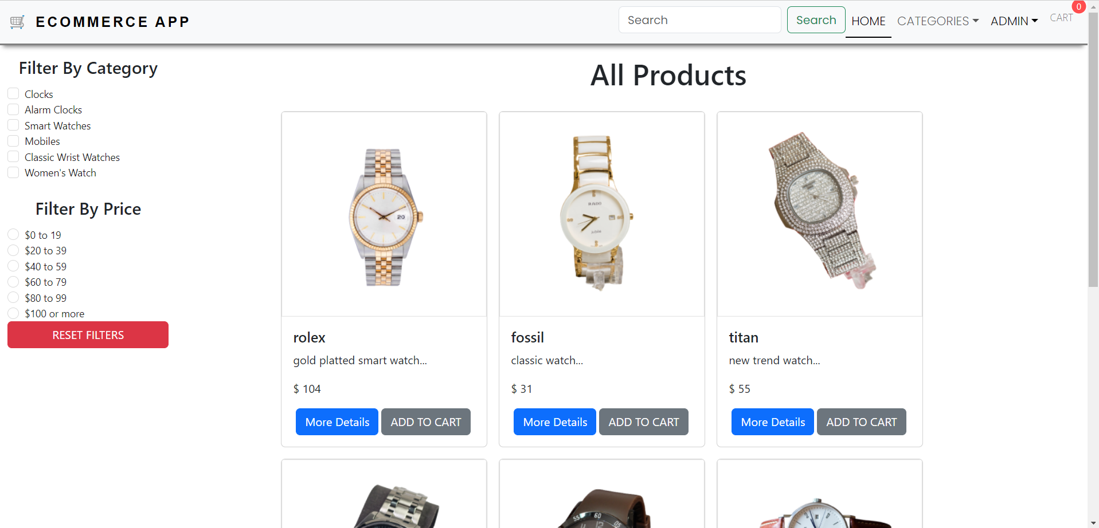

Slide 9
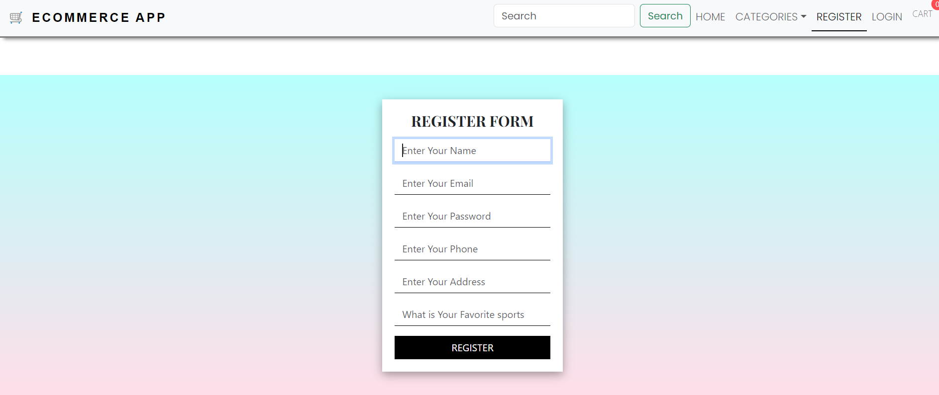

Slide 10
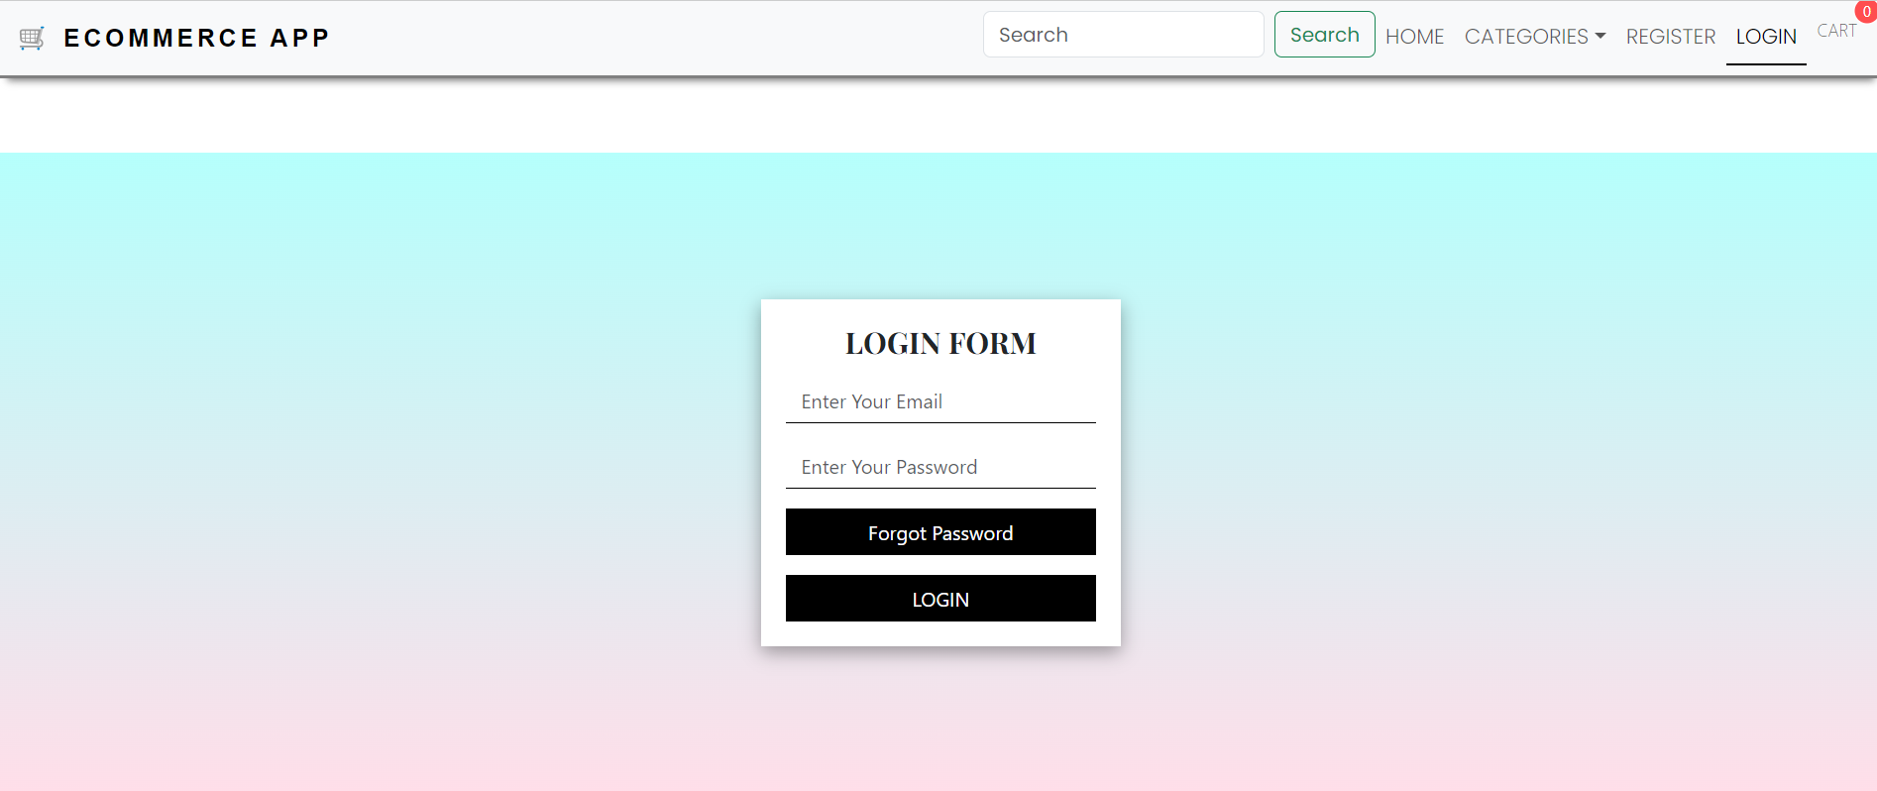

Slide 11
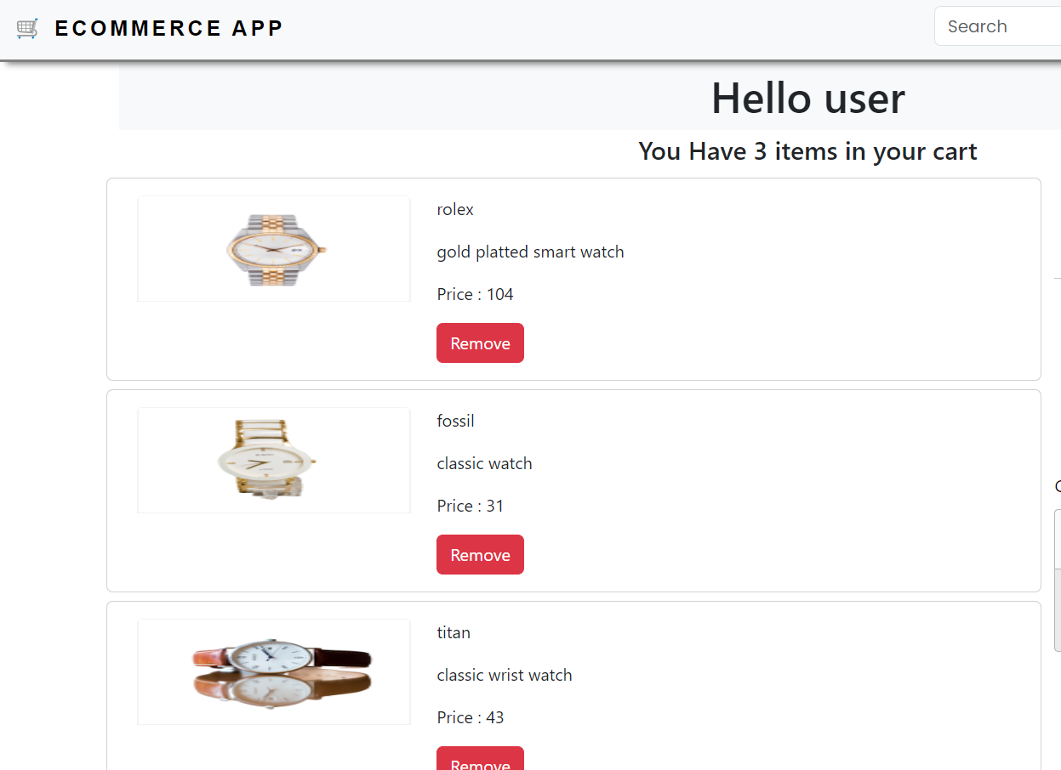

Slide 12
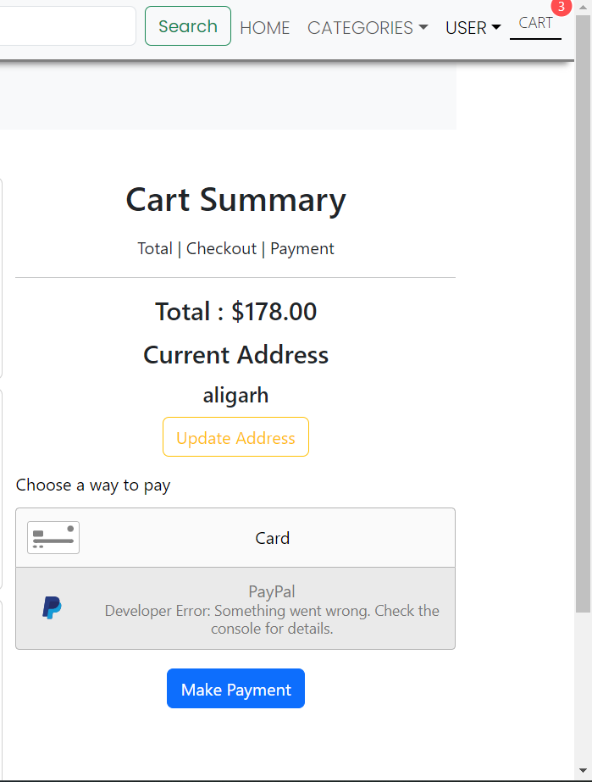
s

Slide 13
vfvfb

Slide 14
Future Work
In future we will add more products to the website for customers so they can easily buy from there.

Slide 15
Conclusion
People can create account on website, they can login or logout any time on the website.
People are able to buy products which are available on website.
People are able to add product to the cart for buy later.

Slide 16


